Slide 1
Windows Server and SQL Server 2008/R2 end of support planning

Slide 2
Abstract and learning objectives
Many customers have huge on-premises footprints of Windows Server and SQL Server 2008 and 2008 R2, but these products are rapidly approaching End of Support. This session is designed to help customers understand the risks of running unsupported software and presents great options for using EOS to modernize in Azure or on-premises.
In this whiteboard design session, you will work with a group to look at the process of migrating workloads to Azure.
At the end of this whiteboard design session, you will leave with the information needed to develop a solid migration plan to keep mission-critical apps and data protected as they are transitioned and modernized. Topics covered will include how to get an inventory of a 2008 server environment, how to categorize 2008 workloads and evaluate the best option for each category, migration and upgrade tools available, TCO analysis tools, offers available from Microsoft to leverage existing licenses and innovations of recent product updates, licensing and technologies.

Slide 3
Step 1: Review the customer case study
Outcome
Analyze your customer needs.
Timeframe
15 minutes

Slide 4
Customer situation Fabrikam
Fabrikam is an automotive parts manufacturer based in the United States. They are an OEM manufacturer of parts for commercial vehicles. They have manufacturing plants throughout the US and Mexico. Fabrikam competes globally with other manufacturers for contracts, this highly competitive environment makes Fabrikam very price sensitive.
"We are preparing for Windows and SQL Server 2008/R2 end of support and would like to better understand our options for upgrade and migration.“
Sloane Peterson, Fabrikam CIO
Fabrikam does not have a complete company wide inventory of the number of servers and applications running on legacy software and many of the systems are undocumented and not well understood by IT staff. They want to understand their current workloads and they would like to take advantage of the cloud where appropriate.
Fabrikam currently has many legacy applications that are running on Windows Server 2008 including a line of business inventory management system that also leverages SQL Server 2008. The inventory management system is considered a mission critical application. It is highly complex and is leveraged by various parts of the business with many upstream and downstream dependencies. Some of these dependencies are Linux systems. Because many of these systems are critical to the business, they need to understand the business continuity and disaster recovery options when upgrading in place or migrating to the cloud.
Notes:
Fabrikam is an automotive parts manufacturer based in the United States. They are an OEM manufacturer of parts for commercial vehicles. They have manufacturing plants throughout the US and Mexico. Fabrikam competes globally with other manufacturers for contracts, this highly competitive environment makes Fabrikam very price sensitive.
Fabrikam is preparing for Windows and SQL Server 2008/R2 end of support and would like to better understand their options for upgrade and migration. Fabrikam does not have a complete company wide inventory of the number of servers and applications running on legacy software and many of the systems are undocumented and not well understood by IT staff. They want to understand their current workloads and they would like to take advantage of the cloud where appropriate.
Fabrikam currently has many legacy applications that are running on Windows Server 2008 including a line of business inventory management system that also leverages SQL Server 2008. The inventory management system is considered a mission critical application. It is highly complex and is leveraged by various parts of the business with many upstream and downstream dependencies. Some of these dependencies are Linux systems. Because many of these systems are critical to the business, they need to understand the business continuity and disaster recovery options when upgrading in place or migrating to the cloud.

Slide 5
Customer situation Fabrikam – Inventory Management
The Inventory Management system is one of the most critical systems at Fabrikam. It was originally architected when the company was much smaller. It currently runs on Windows Server 2008 R2 with a separate SQL Server 2008 backend. The application team that supports it would ultimately like to rearchitect the system for better scalability and to take better advantage of new innovations in inventory tracking. They see cloud technologies as a good fit for this type of application, but they lack the experience, expertise and time to rebuild the application right now.
They would like a short-term plan to maintain support of the system while the application team reskills and gains experience in Azure.
They would also like a long-term plan to take advantage of the new advancements in SQL Server while still getting the most out of their Azure investment by minimizing the administrative overhead.
“We would love to take advantage of the cloud to minimize the administrative overhead of the Inventory Management System, we simply cannot get all of the dependencies sorted out before the official end of support.”
Frances Bradley, Manager Inventory Applications

Slide 6
Customer needs
Identify migration and upgrade tools to help in assessing, migrating and optimizing the current environment.
Fabrikam needs to build an inventory of their current systems and provide some organization around the various systems they have in place. The inventory should include dependencies and tiering of the applications to help in prioritizing application upgrades and migrations.
Fabrikam has a large mix of applications including Microsoft, third-party and custom applications. They need to evaluate the upgrade options for each workload.
They would like to modernize applications and take advantage of the cloud where it makes sense. How should they go about identifying suitable applications and the costs of running them in Azure?
Applications that are not moving to Azure will need to be optimized on-premises.
Fabrikam would like you to provide total cost of ownership analysis of a reference solution they have provided.

Slide 7
Customer objections
We have some third-party applications where we do not have complete control of the code or schema. We will not be able to upgrade these applications before the end of support. What options do we have for these applications?
We have hundreds of applications that are running on servers that are nearing end of support. Some are virtual machines running on VMWare, some are older physical machines. Does Microsoft have any tools to help us identify these applications?
We need to minimize the amount of downtime during migration. How will we do this? What kind of downtime are we looking at?

Slide 8
Customer objections
When migrating workloads into Azure, how do we handle security and authentication? Will workloads continue to use the same authentication that was used on-premises?
Some of our data has very strict regulatory constraints and cannot leave the country of origin, how do we handle this type of data in Azure? Will data be replicated or located in other countries or regions?
How will migrating from SQL Server to Azure SQL Database impact the role of our database administration team?

Slide 9
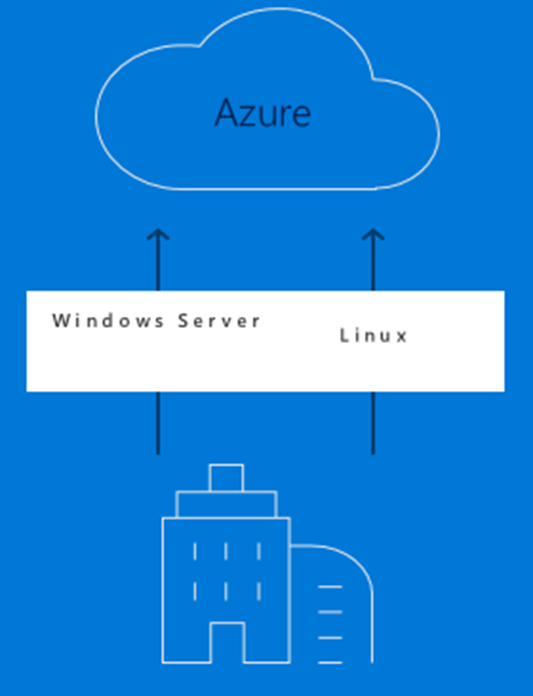
Common scenarios – Azure Migrate
Easily discover VMWare VMs and applications including service dependencies
Workload assessments
Right-size Azure resources based on utilization history
Estimate monthly costs in Azure
Migration risks and recommended tools
Hyper-V support coming soon
Leverage Azure Site Recovery Deployment Planner or partner tools for these workloads
Notes:
https://docs.microsoft.com/en-us/azure/migrate/migrate-overview#current-limitations
Note that support for Hyper-V is on the roadmap.
Hyper-V
Partner tools

Slide 10
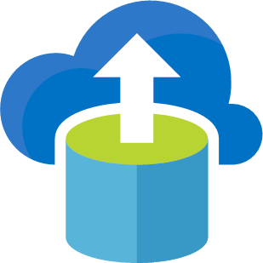
Common scenarios – Database Migration Service
Migrate from multiple database sources to Azure Data platforms with minimal downtime.
Generate assessments of all recommended changes.
Perform associated migration steps.
Notes:
DMA & DEA (A & B testing)

Slide 11
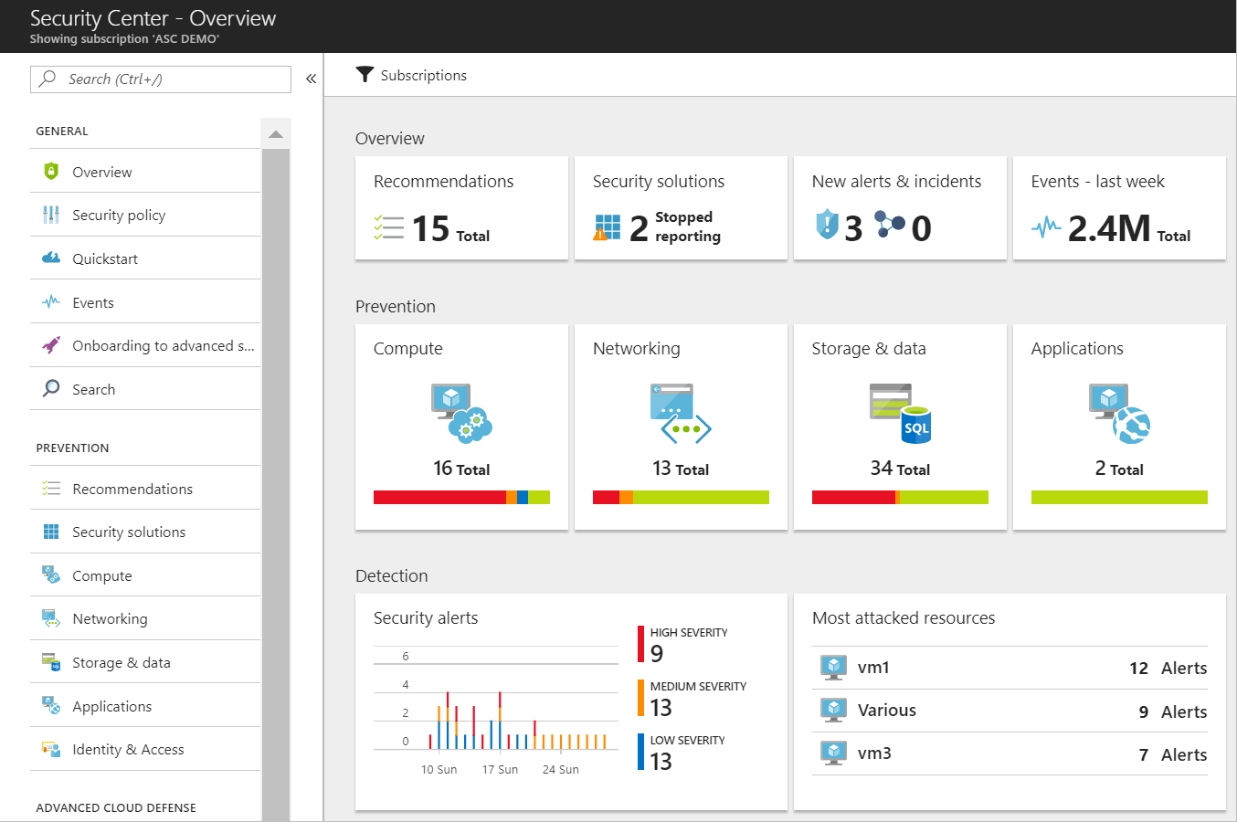
Common scenarios – Azure Security Center
Unified view of security across on-premises and cloud workloads.
Identify and remediate vulnerabilities.
Advanced threat protection.
Centralized security policies.

Slide 12
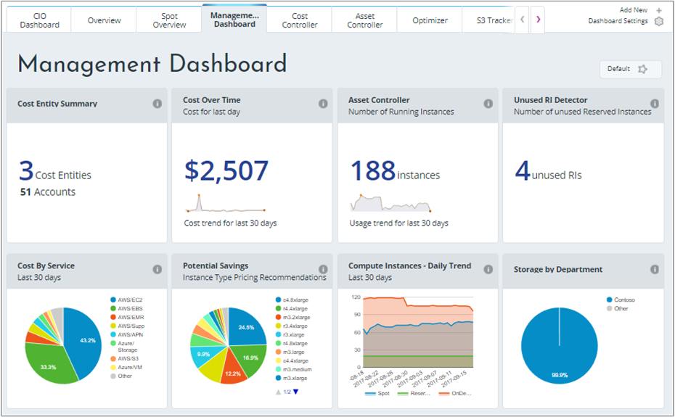
Common scenarios – Cost Management for Azure
Monitor and visualize usage and cost.
Improve organizational accountability.
Optimize cloud efficiency.
Notes:
TCO calculator comparison

Slide 13
Step 2: Design the solution
Outcome
Design a solution and prepare to present the solution to the target customer audience in a 15-minute chalk-talk format.
Timeframe
60 minutes
Business needs (10 minutes) | Respond to questions outlined in your guide and list the answers on a flipchart.
Design (35 minutes) | Design a solution for as many of the stated requirements as time allows. Show the solution on a flipchart.
Prepare (15 minutes) | Identify any customer needs that are not addressed with the proposed solution. Identify the benefits of your solution. Determine how you will respond to the customer’s objections. Prepare for a 15-minute presentation to the customer.

Slide 14
Step 3: Present the solution
Outcome
Present a solution to the target customer in a 15-minute chalk-talk format.
Timeframe
30 minutes (15 minutes for each team to present and receive feedback)
Directions
Pair with another table.
One table is the Microsoft team and the other table is the customer.
The Microsoft team presents their proposed solution to the customer.
The customer asks one of the objections from the list of objections in the case study.
The Microsoft team responds to the objection.
The customer team gives feedback to the Microsoft team.

Slide 15
Wrap-up
Outcome
Identify the preferred solution for the case study.
Identify solutions designed by other teams.
Timeframe
15 minutes

Slide 16
Preferred target audience
Sloane Peterson, CIO
Jude Watkins, Director of Database Operations
Frances Bradley, Manager Inventory Management Applications

Slide 17
Preferred solution overview
The solution for Fabrikam's scenario :
Assessment consisting of three steps; discovery, mapping, and evaluation of all the systems in the organization.
Migration of resources. Out of the assessment we will decide if we should rehost, refactor, rearchitect or rebuild each workload.
Optimize our workloads by improving business continuity capability, enhancing security and compliance, and optimizing cost.
Let’s review in more detail.

Slide 18
Preferred solution – Assess Assessment can be broken down into three phases
Discovery: In the discovery phase you will collect information about your various workloads. At the end of this phase you should have an inventory of all your servers.
Mapping: Identify dependencies between servers. Groups servers logically to represent applications.
Evaluate: Evaluate groups for compatibility and cost. Select a migration strategy based on application requirements and migration objectives.
Notes:
**Inventory**: Fabrikam needs to build an inventory of their current systems. Determine what needs to be tracked in this inventory. What information would you track in your inventory to help Fabrikam organize and prioritize systems for their end of support planning? How would you prioritize systems?
**Answer:** Inventory data should include server metadata and performance metrics about your applications. At the end of this step, you’ll have a complete inventory of servers with metadata for each including any dependencies with other applications allowing you to build a cloud migration plan.
When assigning priority, there are a couple factors to consider. If your organization is relatively new to cloud it is best to start with smaller, less complex applications to gain experience and confidence. This also allows you to work out any process or governance issues that you may have overlooked.

Slide 19
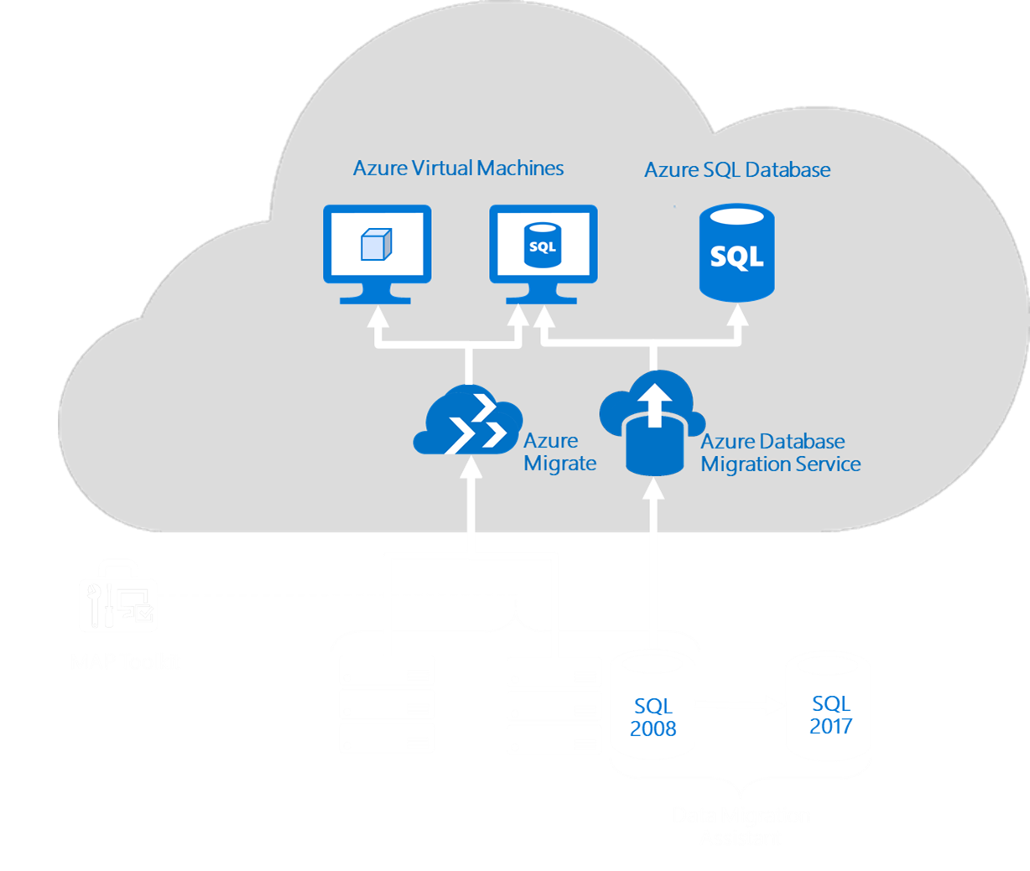
Preferred solution – Assess
Tools
Azure Migrate
Microsoft Assessment and Planning Toolkit
Database Migration Guide
Azure Database Migration Service
Data Migration Assistant
Database Experimentation Assistant
Notes:
**Tools:** Identify any tools that Fabrikam might use to help with assessments, migrations and optimizations of their Windows Server and SQL Server systems.
**Answer:** There are several critical tools available to Fabrikam to assist with environment assessment. There are also multiple facets to assessing an environment.
Azure Migrate: Use Azure Migrate to assess known windows instances. Currently, the Azure Migrate service only supports discovery of machines hosted in VMWare, physical and Hyper-V hosted machines are coming soon.
Microsoft Assessment and Planning Toolkit: The MAP Toolkit provides agentless discovery and inventory of computers and applications, hardware and software migration readiness assessments, software usage tracking, and capacity planning for virtualization, public and private cloud migration.
Database Migration Guide: The Database Migration Guide creates a custom report on how to migrate your source data to the destination of your choice: on-premises, cloud, private cloud, IaaS or PaaS
Azure Database Migration Service: Use the Azure Database Migration service to analyze existing on premises databases and migrate them to Azure SQL Database or Azure SQL Databases Managed Instances.
Data Migration Assistant: Data Migration Assistant (DMA) enables you to upgrade to a modern data platform by detecting compatibility issues that can impact database functionality on your new version of SQL Server. It recommends performance and reliability improvements for your target environment. It allows you to not only move your schema and data, but also uncontained objects from your source server to your target server.
Database Experimentation Assistant: Database Experimentation Assistant (DEA) is an A/B testing solution for SQL Server upgrades. It will assist in evaluating a targeted version of SQL Server for a given workload. Customers who are upgrading from previous SQL Server versions (SQL Server 2005 and above) to any new version of the SQL Server will be able to use these analysis metrics.

Slide 20
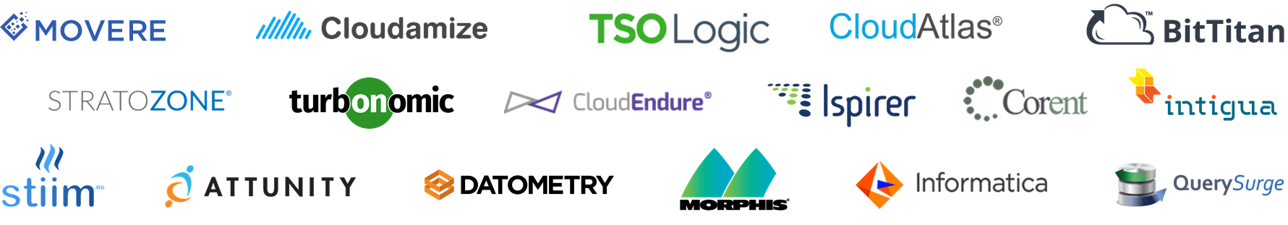
Preferred solution – Assess
Migration Partners
Managed Service Providers can help you drive migration initiatives and manage your resources once they're in Azure.
Systems integrators can help you drive migration initiatives by providing project management and technical consulting.
Notes:
Add a link to the partner site & azure migration center

Slide 21
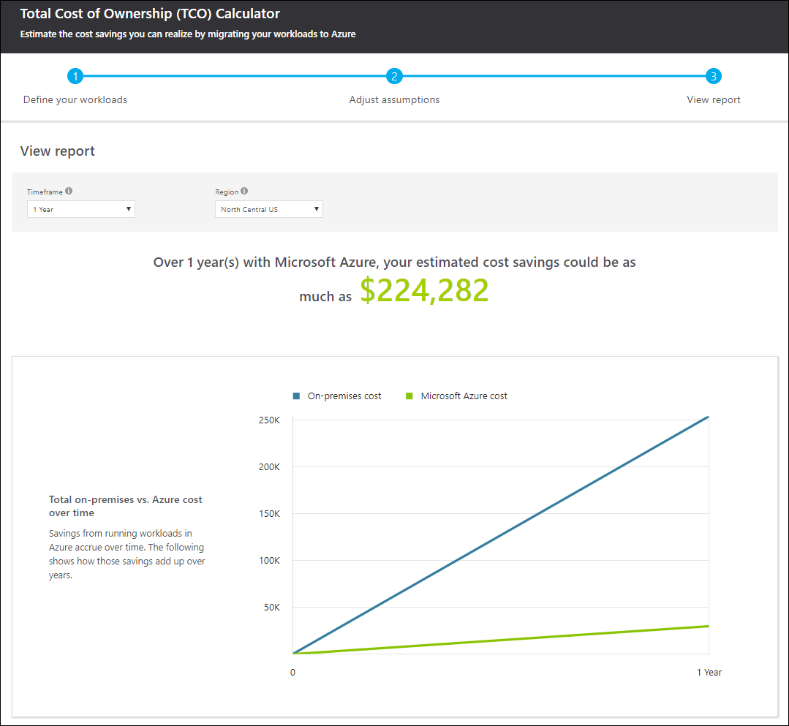
Preferred solution – Assess
Cost/Benefit Analysis
Maintain the current version
Extended Security Updates.
Tiered pricing model.
Rehost to Azure Virtual Machines
Flexibility and scalability of the cloud.
Take advantage of Azure Hybrid Benefits.
3 years of Extended Security Updates for Azure Virtual Machines at no charge.
Use the Azure TCO Calculator to estimate cost savings.
Notes:
- **Cost/Benefit Analysis:** Fabrikam currently has Software Assurance. Provide a high-level cost/benefit analysis of the following options available to Fabrikam:
a. Maintain current version
b. Rehost - Migrate to cloud
**Answer:** Fabrikam has several options they can take advantage of depending on the strategy they choose for each application workload.
a. If they are not in a position to upgrade a given system immediately, they can purchase Extended Security Updates. Extended Security Updates allows you to purchase up to 3 years of additional security updates for Windows Server and SQL Server 2008 and 2008 R2.
b. Rehosting to Azure give you the flexibility and scalability of the cloud. Fabrikam can take advantage of Azure Hybrid Benefits for Windows and SQL when migrating to Azure. Additionally, migrating your virtual machines to Azure virtual machines will get you 3 more years of Extended Security Updates for Windows Server and SQL Server 2008/R2 at no additional charge.
For Windows Server, Azure Hybrid Benefit saves Fabrikam the OS costs when migrating to an Azure Virtual Machine and an additional 3 years of Extended Security Updates.
2-proc license = 16 cores
When migrating databases to Azure SQL Database Fabrikam can also take advantage of Azure Hybrid Benefit. If Fabrikam opts to migrate to an Azure Virtual Machine they can take advantage of the 3 years of Extended Security Updates.
Standard Edition license = 1x General Purpose vCore
Enterprise Edition license = 4x General Purpose vCore
For those that cannot migrate to Azure there is also an option to purchase Extended Security Updates.
To estimate cost savings, Fabrikam should use the Azure TCO Calculator.

Slide 22
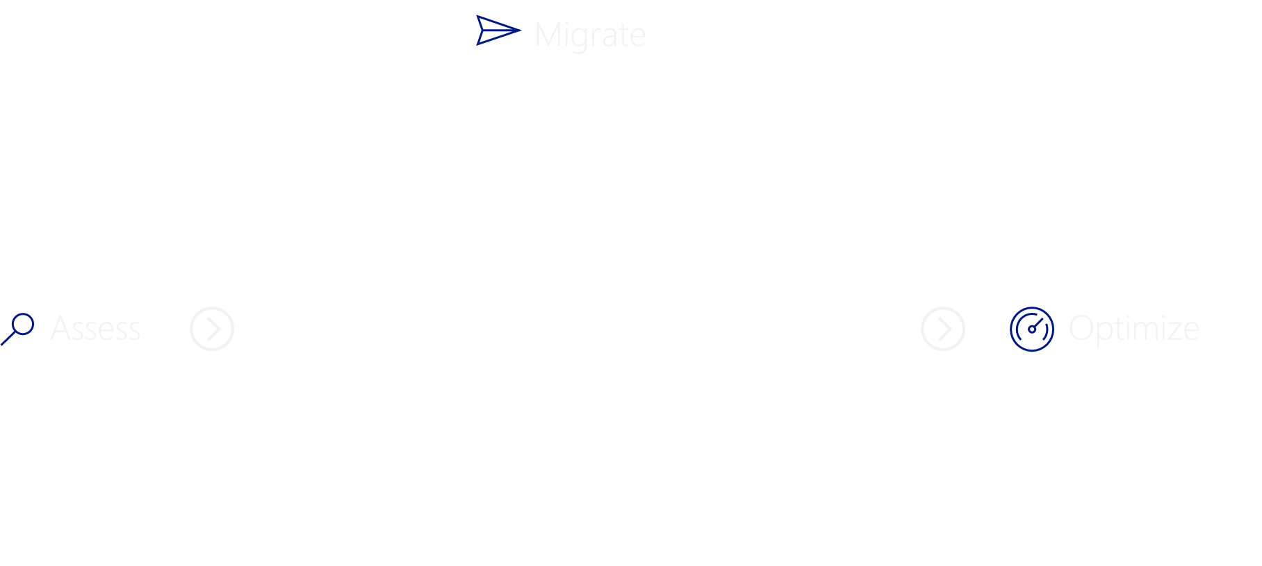
Preferred solution – Migrate The migration phase can be broken out into four paths
Notes:
There are four cloud migration strategies, rehost, refactor, rearchitect and rebuild.

Slide 23
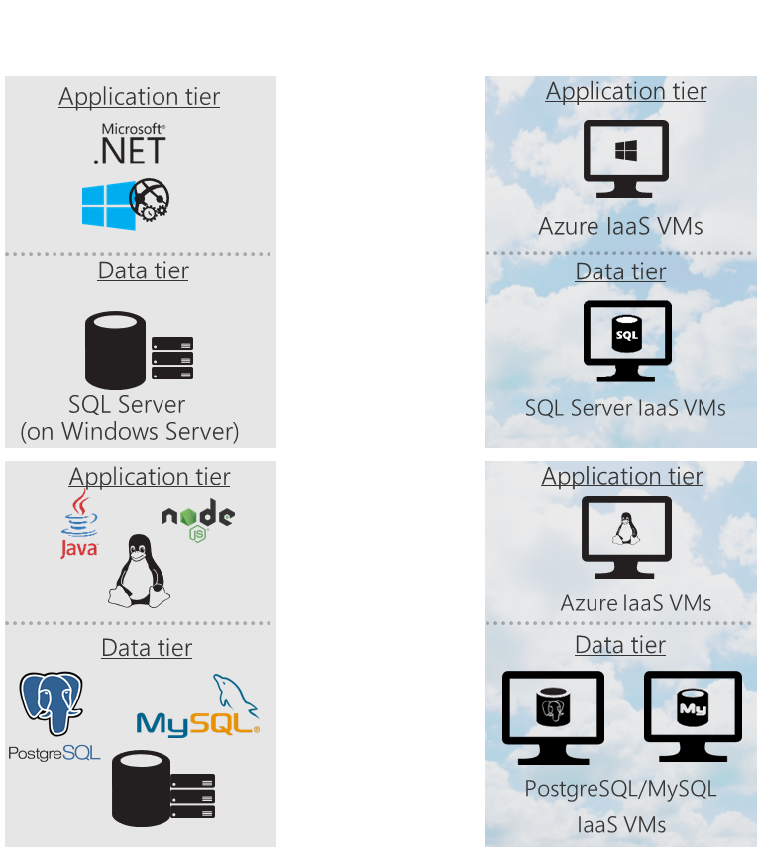
Preferred solution – Migrate
Rehost
(lift & shift)
No code changes
Applications migrated as-is
Fast migration
Low risk
Use when:
Need to migrate quickly
Apps already architected for IaaS
Changes not needed in application
Requirements of application can only be met with IaaS.
Cannot change application code
Notes:
Rehost: This strategy is often referred to as "lift and shift" migration, this no-code option lets you migrate your existing applications to Azure quickly. Each application is migrated as-is, which provides the benefits of the cloud without the risks or costs of making code changes.
Use cases:
You need to move applications from your datacenter to the cloud quickly.
Your apps are architected to leverage Azure IaaS scalability.
Your business requires the applications but doesn’t need to change their capabilities right away.
Your applications or database requirements can only be met using an Azure IaaS VM.
You need to move the application with no code changes

Slide 24
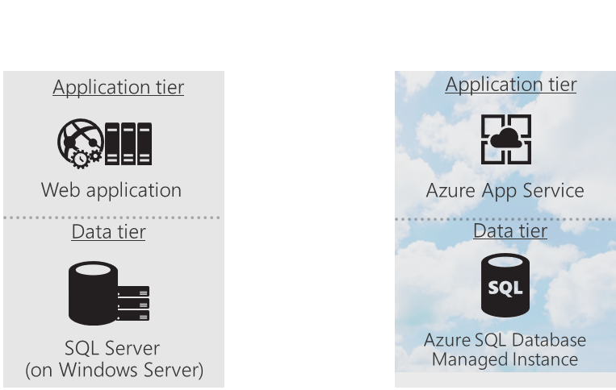
Preferred solution – Migrate
Refactor
"Repackaging"
Migrate to PaaS with minimal changes.
Take better advantage of the cloud.
Use when:
Need to use existing code base and skills
Application can be easily repackaged to work in Azure.
You want to apply DevOps practices in Azure
You are applying a container strategy to certain workloads.
Notes:
Refactoring, often referred to as "repackaging," is a cloud migration approach that lets you minimally alter application code or apply configuration changes necessary to connect the application to Azure PaaS and take better advantage of the cloud. For example, you can move your existing apps to Azure App Service or Azure Kubernetes Service (AKS). You can also refactor your relational and non-relational databases into Azure SQL Database Managed Instance, Azure Database for MySQL, Azure Database for PostgreSQL, and Azure Cosmos DB
Use cases:
You need to use an existing code base and development skills, and code portability is a concern.
Your application can be easily repackaged to work in Azure.
You want to apply innovative DevOps practices provided by Azure.
Your IT team is investing in DevOps using a container strategy for certain workloads.

Slide 25
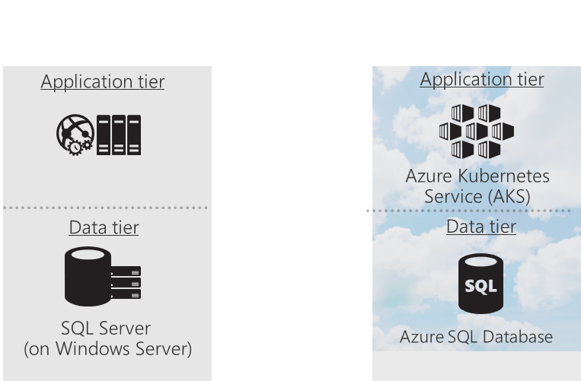
Preferred solution – Migrate
Rearchitect
Modify application code base to optimize for cloud.
Use when:
Application needs a major revision to incorporate new functionality or work effectively in the cloud.
You want to make use of existing application investments.
You want to minimize the use of virtual machines.
You want to apply DevOps practices in Azure.
Notes:
Modify or extend an existing application's code base to optimize the application architecture for cloud scale. For example, decompose a monolithic application into microservices that work together and readily scale. And rearchitect your relational and non-relational databases to Azure fully-managed DBaaS solutions, like Azure SQL Database Managed Instance, Azure Database for MySQL, Azure Database for PostgreSQL, and Azure Cosmos DB.
Use cases:
Your application needs a major revision to incorporate new capabilities or to work more effectively on a cloud platform.
You want to make use of existing application investments.
You want to meet scalability requirements in a cost-effective way.
You want to minimize use of virtual machines.
You want to apply innovative DevOps practices provided by Azure.

Slide 26
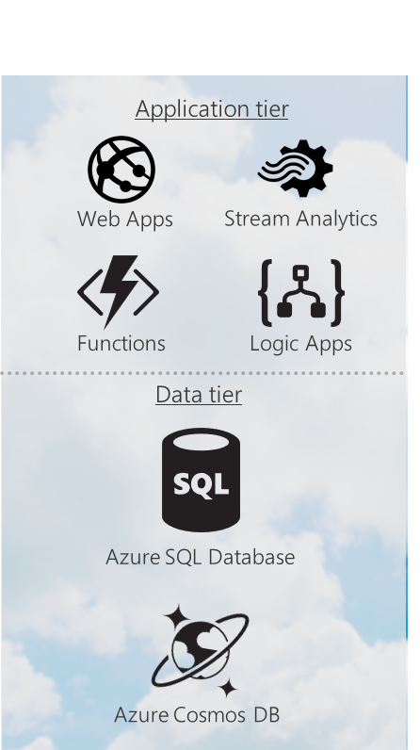
Preferred solution – Migrate
Rebuild
Rebuild an application from scratch using cloud-native technology.
Use when:
You want rapid development.
Existing application is functionally limited.
You are ready to build applications with cloud-native technology.
You want to take advantage of advances in AI, blockchain and IoT.
You want to apply DevOps practices in Azure.
Notes:
Rebuild an application from scratch using cloud-native technologies from Azure. For example, build greenfield applications with cloud-native technologies like serverless, Azure AI, Azure SQL Database Managed Instance, Azure Cosmos DB, and others
Use cases:
You want rapid development, and the existing application is limiting in terms of functionality and lifespan.
You’re ready to build new applications using cloud-native technologies.
You want to build innovative apps taking advantage of advancements in AI, blockchain, and IoT.
You want to expedite your business innovation.
You want to apply innovative DevOps practices provided by Azure

Slide 27
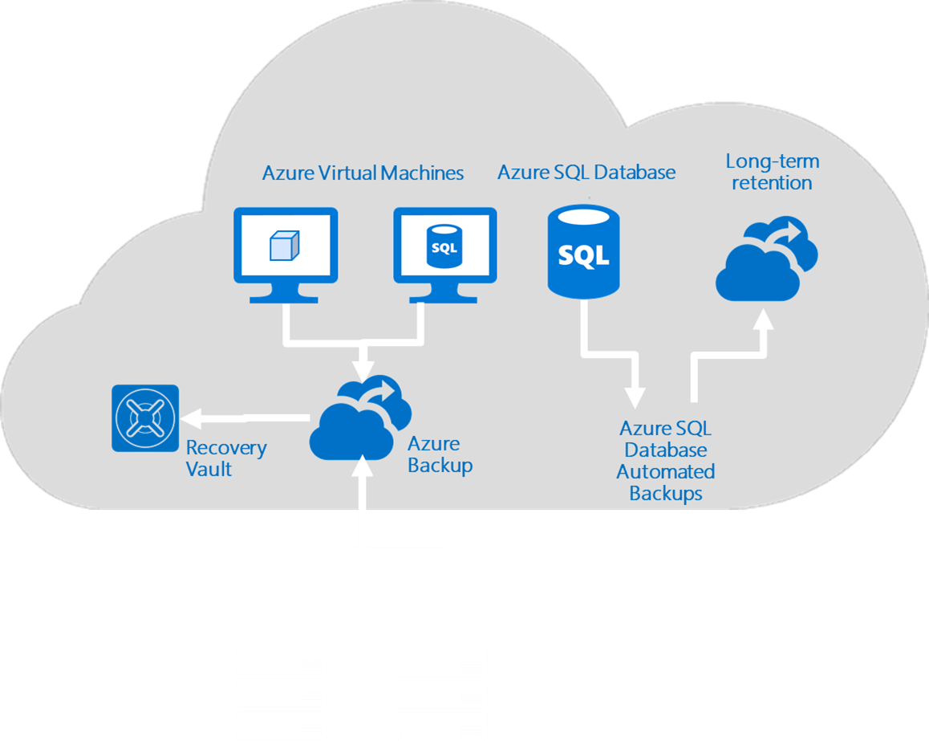
Preferred solution – Optimize
Business Continuity and Disaster Recovery
Virtual machines in Azure can be backed up using Azure Backup.
Application-consistent backups stored into geo-redundant storage.
Backup on-premises or cloud.
Backups are encrypted by default.
Backups will be stored in a Recovery Services vault with the ability to specify daily, weekly, monthly and yearly retention policies .
Azure SQL Databases HADR
99.99% uptime SLA, up to 4 async replicas for DR
Default backup retention is 35 days.
Long term retention of up to 10 years.
The automated backup is copied to Azure Storage.
Frequency of the copy is determined by a policy.
Notes:
- **Business Continuity and Disaster Recovery:** - With potentially hundreds of virtual machines deployed to Azure, how do we handle backup of virtual machines in Azure? How about Azure SQL Database HADR? How is are our SQL Databases protected? We have heard that backup retention is limited to 35 days, but we need to keep backups for 7 years for compliance?
**Answer:** Azure Backup can be used to backup your Azure virtual machines and your on-premises servers. It provides encrypted, application-consistent backups stored in geo-redundant storage. Azure Backup will store backups in a Recovery Services vault located in the same region as your virtual machines.
All SQL Databases a guaranteed 99.99% uptime for high availability. You may additionally deploy up to four asynchronous replicas into any region to support disaster recovery scenarios or scale out read workloads.
All SQL Databases are automatically backed up. The automatic backup retention is 35 days for Standard and Premium tier databases. However, SQL Database can be configured for long term backup retention of up to 10 years. This works by copying the automated backup into an Azure Storage Account. The frequency of the copy is determined by a policy that you create.

Slide 28
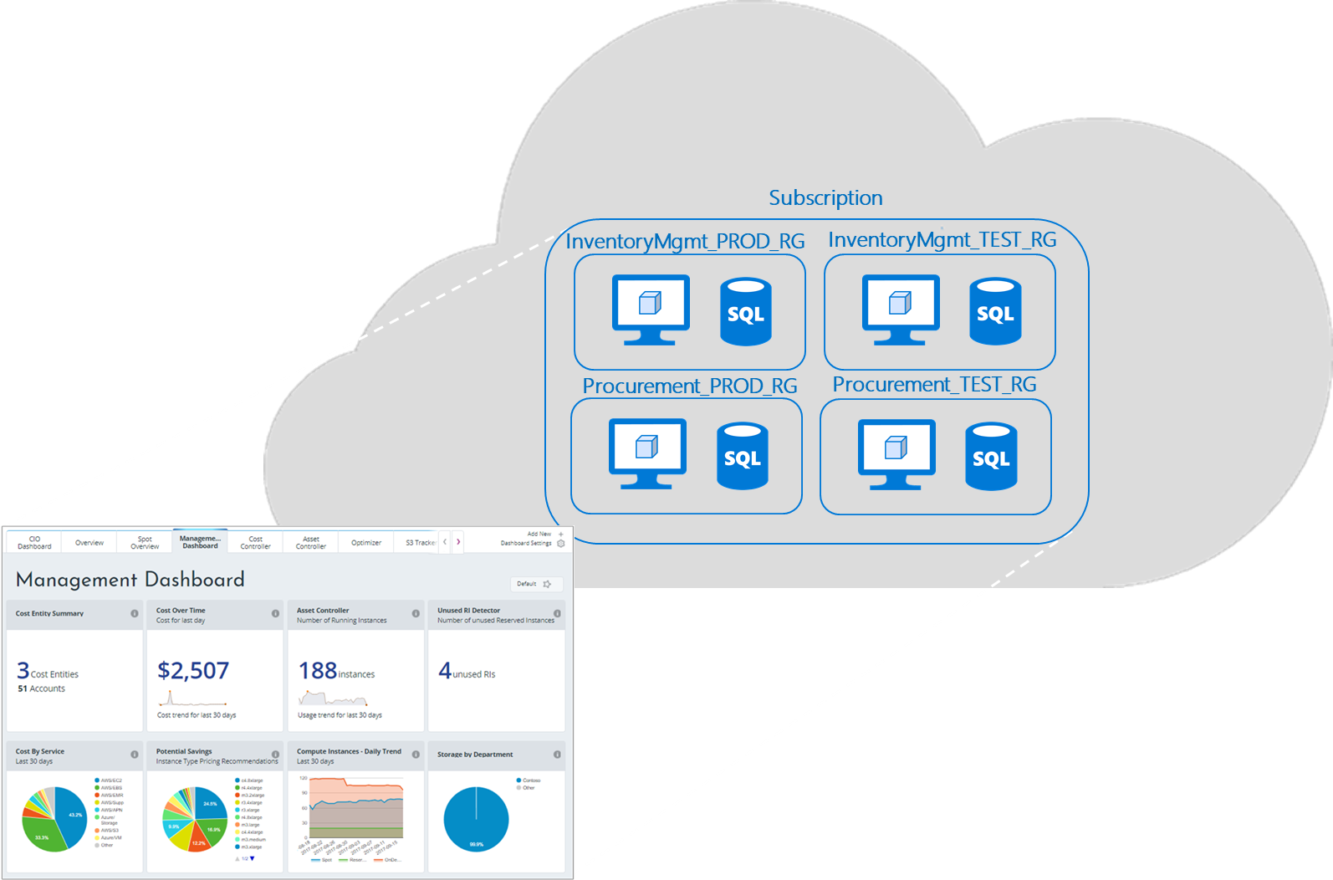
Preferred solution – Optimize
$
Cost Management
Azure Cost Management
Track cloud usage and expenditures.
Cross cloud usage tracking.
Tracking based on tagging policy.
Alerting for anomalous or overspending.
Identify idle or underutilized virtual machines .
Notes:
- **Cost management:** - With the ease of deploying and scaling services in the cloud we are concerned about cost management. What tools can we leverage to help us with cost management?
**Answer:** Azure Resource Manager policies and role-based access control provide governance to your cloud environment. You can limit the type and scale of resources deployed to Azure. You can also enforce tagging policies, the resulting tags can then be used to track things like department, project name etc.
To manage cost in the Azure environment you can leverage Azure Cost Management. Azure Cost Management allows you to track cloud usage and expenditures for your Azure resources and other cloud providers including AWS and Google. Azure Cost Management allows you to track all your costs based on your tagging policy. It allows for alerts for notifying you automatically when unusual spending or overspending occurs. It also allows you to improve efficiency by identifying idle virtual machines or removing unattached disks.

Slide 29
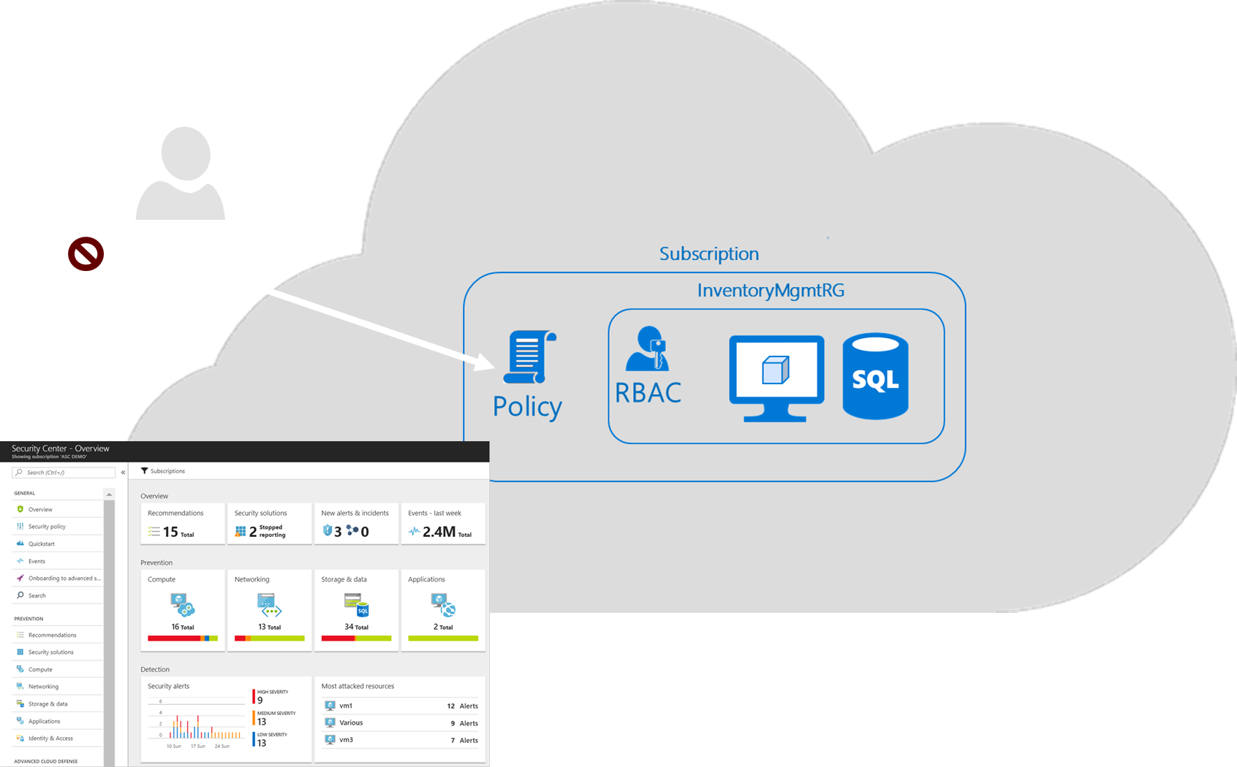
Preferred solution – Optimize
Compliance
Resource Manager Policies
Restrict resource types
Restrict regions
Enforce tagging policy
Enforce naming conventions
Role Based Access Control
Azure Security Center
Centralized policy management
Continuous security assessment
Actionable recommendations
Advanced cloud defenses
Integrated security solutions
Notes:
- **Compliance:** - We want to make sure that our cloud resources are properly secured so that we can maintain compliance. How do we monitor security and maintain compliance in the cloud? What about systems that remain on premises?
**Answer:** Azure Resource Manager policies and role-based access control provide governance to your cloud environment. With policies you can define the types of resources that can be deployed and the regions in which they can be deployed. You can also enforce naming conventions, tag resources and other governance related operations.
Role based access control allows you to limit access to subscriptions, resource groups and resources.
Azure Security Center provides
Centralized policy management – Ensure compliance with company or regulatory security requirements by centrally managing security policies across all your hybrid cloud workloads.
Continuous security assessment – Monitor the security posture of machines, networks, storage and data services, and applications to discover potential security issues.
Actionable recommendations – Remediate security vulnerabilities before they can be exploited by attackers with prioritized and actionable security recommendations.
Prioritized alerts and incidents - Focus on the most critical threats first with prioritized security alerts and incidents.
Advanced cloud defenses – Reduce threats with just in time access to management ports and adaptive application controls running on your VMs.
Integrated security solutions - Collect, search, and analyze security data from a variety of sources, including connected partner solutions.

Slide 30
Preferred objections handling
Objection
We have some third-party applications where we do not have complete control of the code or schema. We will not be able to upgrade these applications before the end of support. What options do we have for these applications?
Potential answer
Since Fabrikam has Software Assurance benefits, they are eligible to purchase Extended Security Updates for those servers that may not be upgraded due to supportability or third-party support requirements all while allowing you to maintain compliance.

Slide 31
Preferred objections handling
Objection
We have hundreds of applications that are running on servers that are nearing end of support. Some are virtual machines running on VMWare, some are older physical machines. Does Microsoft have any tools to help us identify these applications?
Potential answer
Microsoft provides a variety of free migration tools to assist with migration planning and execution. In addition, if the tools provided do not meet a specific need, Microsoft has a rich ecosystem of partners that provide migration tools and consulting as well.
Azure Migrate
Microsoft Assessment and Planning Toolkit
Notes:
Microsoft provides a variety of free migration tools to assist with migration planning and execution. In addition, if the tools provided do not meet a specific need, Microsoft has a rich ecosystem of partners that provide migration tools and consulting as well.
Azure Migrate: Use Azure Migrate to assess known windows instances. Currently, the Azure Migrate service only supports discovery of machines hosted in VMWare, physical and Hyper-V hosted machines are coming soon.
Microsoft Assessment and Planning Toolkit: The MAP Toolkit provides agentless discovery and inventory of computers and applications, hardware and software migration readiness assessments, software usage tracking, and capacity planning for virtualization, public and private cloud migration.
***Not really for identifying and inventory but…
Azure Database Migration Service: Use the Azure Database Migration service to analyze existing on premises databases and migrate them to Azure SQL Database or Azure SQL Databases Managed Instances.

Slide 32
Preferred objections handling
Objection
We need to minimize the amount of downtime during migration. How will we do this? What kind of downtime are we looking at?
Potential answer
Different systems will have different requirements when it comes to application migration. While some systems might be fine with a weekend outage, others will require minimal downtime on the order of minutes or seconds. For those systems that require minimal downtime we can leverage tools such as the Azure Database Migration Service for near-zero downtime.

Slide 33
Preferred objections handling
Objection
When migrating workloads into Azure, how do we handle security and authentication? Will workloads continue to use the same authentication that was used on-premises?
Potential answer
Azure Active Directory is Microsoft's cloud-based directory and identity management service. It provides directory services, application access management and identity protection. Azure AD also supports hybrid identity with your on-premises Active Directory allowing you to synchronize on-premises directory objects while still managing your users on-premises.
Notes:
Azure Active Directory is Microsoft's cloud-based directory and identity management service. It provides directory services, application access management and identity protection. Azure AD also supports hybrid identity with your on-premises Active Directory allowing you to synchronize on-premises directory objects while still managing your users on-premises. Synchronized identities, and optionally password hashes, enable your users to use the same password to access both on-premises and cloud-based organizational resources. For more advanced scenario requirements, such as single-sign-on (SSO) or on-premises multi-factor authentication (MFA), you need to deploy Active Directory Federation Services (AD FS) to federate identities

Slide 34
Preferred objections handling
Objection
Some of our data has very strict regulatory constraints and cannot leave the country of origin, how do we handle this type of data in Azure? Will data be replicated or located in other countries or regions?
Potential answer
Azure has datacenters all over the world. Your data will reside in the region in which you create your resources. Any platform-provided replication, such as storage account replication, will be to the paired region which is usually in the same geography. There are exceptions to this rule though, you can see a table of all the Azure paired regions here: https://docs.microsoft.com/en-us/azure/best-practices-availability-paired-regions

Slide 35
Preferred objections handling
Objection
How will migrating from SQL Server to Azure SQL Database impact the role of our database administration team?
Potential answer
Database Administrators still perform many of the tasks that are done on premises. For example, design and configuration for high availability and disaster recovery, storage management, performance tuning of critical workloads, responding to alerts, scripting and managing database environments. The nature of how these tasks are approached will change with many of the automation and intelligent features in Azure SQL Database, allowing database administrators to focus on higher value tasks and less on the menial day-to-day tasks.

Slide 36
Customer quote
“With Microsoft's server and database migration tools we have the building blocks we need to accelerate our cloud strategy while minimizing migration downtime and maintaining compliance.”
—Jude Watkins, Director of Database Operations, Fabrikam

